Slide 1
DarkLight Trigger Paddle Assembly Procedure
Instructions composed by Gabby Gelinas for the procedure developed by Nicholas Massacret

Slide 2
0. Prep work
This guide explains how to assemble a trigger paddle. Before beginning these instructions, you must have two scintillators with light guides attached and wrapped in mylar, and all parts of the holder printed and ready
This assume you have already cut the foam and skin using the cricut

Slide 3
0. Materials
Other materials
To use in scintillator shop:
Everything in “how to make silicone” manual
To use above detector facility:
Kim wipes or equivalent
Kapton
10 mL syringe
Needle (I like 16 1/2 gauge, dealer’s choice)
Isopropyl alcohol
Scotch tape
Copper spacer
Silicone cookie
Foam
Skin (thin insulating material)
Tedlar
3D printed materials
Scintillator holder
Plate insert for holder
Back cover
Jig (reusable)
Silicone cookie mold
Tools
Small Phillips screwdriver
Small blunt screwdriver
Tweezers
Razor blade
Popsicle stick
Heat press

Slide 4
0. Materials
Nuts and screws
Item | Quantity
18-8 Stainless Steel Socket Head Screw, (McMaster # 91292A264) | 4
18-8 Stainless Steel Hex Nut, M1.6 x 0.35 mm Thread (McMaster # 91828AM1.6 x 0.35 mm Thread, 8 mm Long 006) | 4
Brass Tapered Heat-Set Inserts for Plastic, M2 x 0.4 mm Thread Size, 2.9 mm Installed Length (McMaster # 94180A307) | 10
M2x6mm screws | 7
M2x10mm screws | 3
More screws, nuts, and washers are used in assembling the frame, but you can just use what is already in the frame since you won’t be building a new frame, just making repairs.

Slide 5
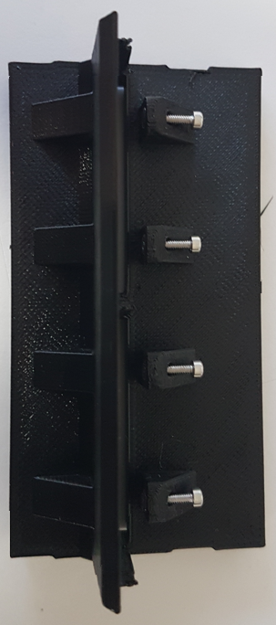
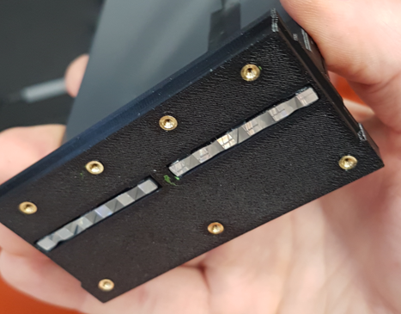
1. Prep the holder. Above detector facility
Insert the heat inserts into the seven holes on the back of the holder using Alec’s press. It’s very important they go in straight. After inserting one, push down on it with something wood (like a popsicle stick) for 10 seconds to make sure they don’t lift up. They should be flush with the holder.
The tip of the press must be thoroughly cleaned before doing this or the inserts will fill with plastic.
Insert the M1.6 x 0.35 mm thread, 8 mm long screws and nuts into the holder. This can take a while because the nuts love to fall out. I like to use tweezers to hold the nuts in place while I work, screw the screws partially in with the nut on the end, then pull the screw to get the nut into the hole. Find your own style.
Keep the screws inserted enough that they stick out the other end and overhang the nut so the nut doesn’t fall out, but not so far that it gets in your way of putting the scintillator in in the next step. Heat inserts are also added to the middle row of the back cover.
Holder
No scintillator yet
Heat insert
Nut goes here

Slide 6
2. Scintillators in the holder.
Clean your work bench
Lay the scintillators flat on your bench parallel to and touching each other and make sure they are lined up exactly at their ends
Use squeeze them together and use scotch tape to attach the two scintillators to each other
Put a piece of Kapton or a large Kim wipe down and put the holder flat on the table. Gently slide the scintillators into the hole as shown on the next slide. The light guides should be flush with the opening or even sticking out a little bit

Slide 7
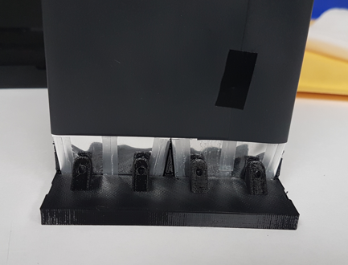
2. Scintillators in the holder
This is what it should look like
Don’t do this! Put the light guide end down on something clean and smooth. A cleaned table doesn’t count!

Slide 8
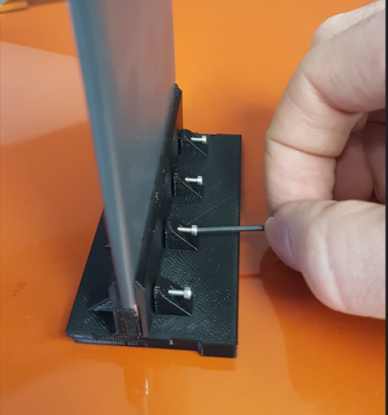
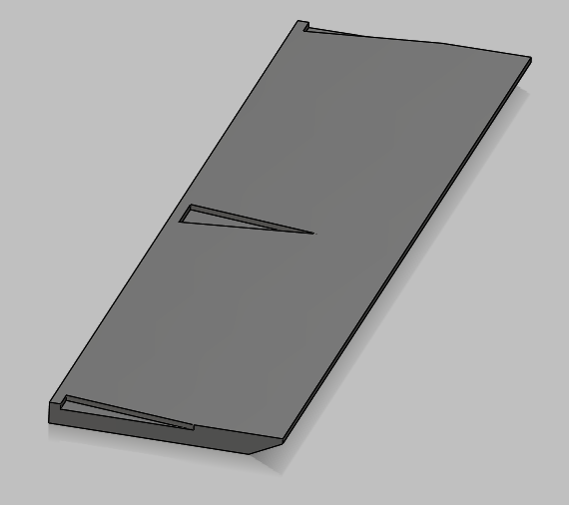
3. Add plate
Slide the plate into the space between the screws and the scintillators, so you have symmetric coverage of the scintillators on both sides. The plate is directional, match the direction of the slant to the plate already attached to the holder
I like to do this by putting the plate partially in, pressing down and slowly unscrewing the screws as I push the plate down so the nuts don’t fall out
Once the plate is inserted, tighten the screws so they apply light pressure to the plate. Do all of this with the paddle vertical and resting on the your clean surface
The plate

Slide 9
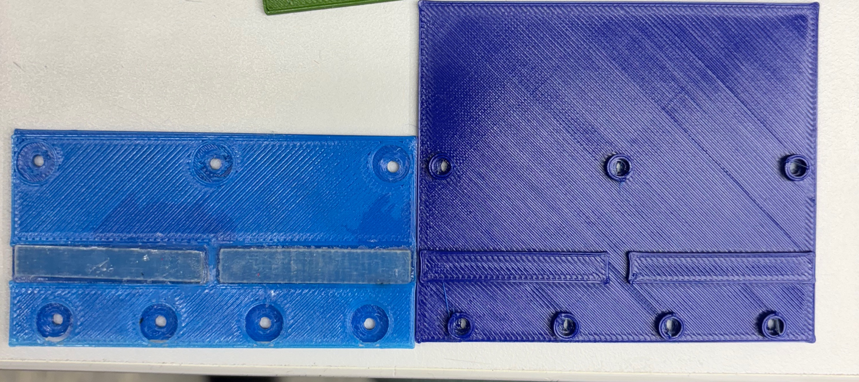
4. Prepare the jig
Clean a jig with isopropyl alcohol. All components need to be cleaned before assembly
Stick a piece of pre-cut foam onto the copper spacer
Click a copper spacer into the jig
Place a rectangle of Kapton the same size as the rectangular bump on the jig on top of each bump
Jigs, either kind is good
Where the Kapton (and next the silicone cookie) goes

Slide 10
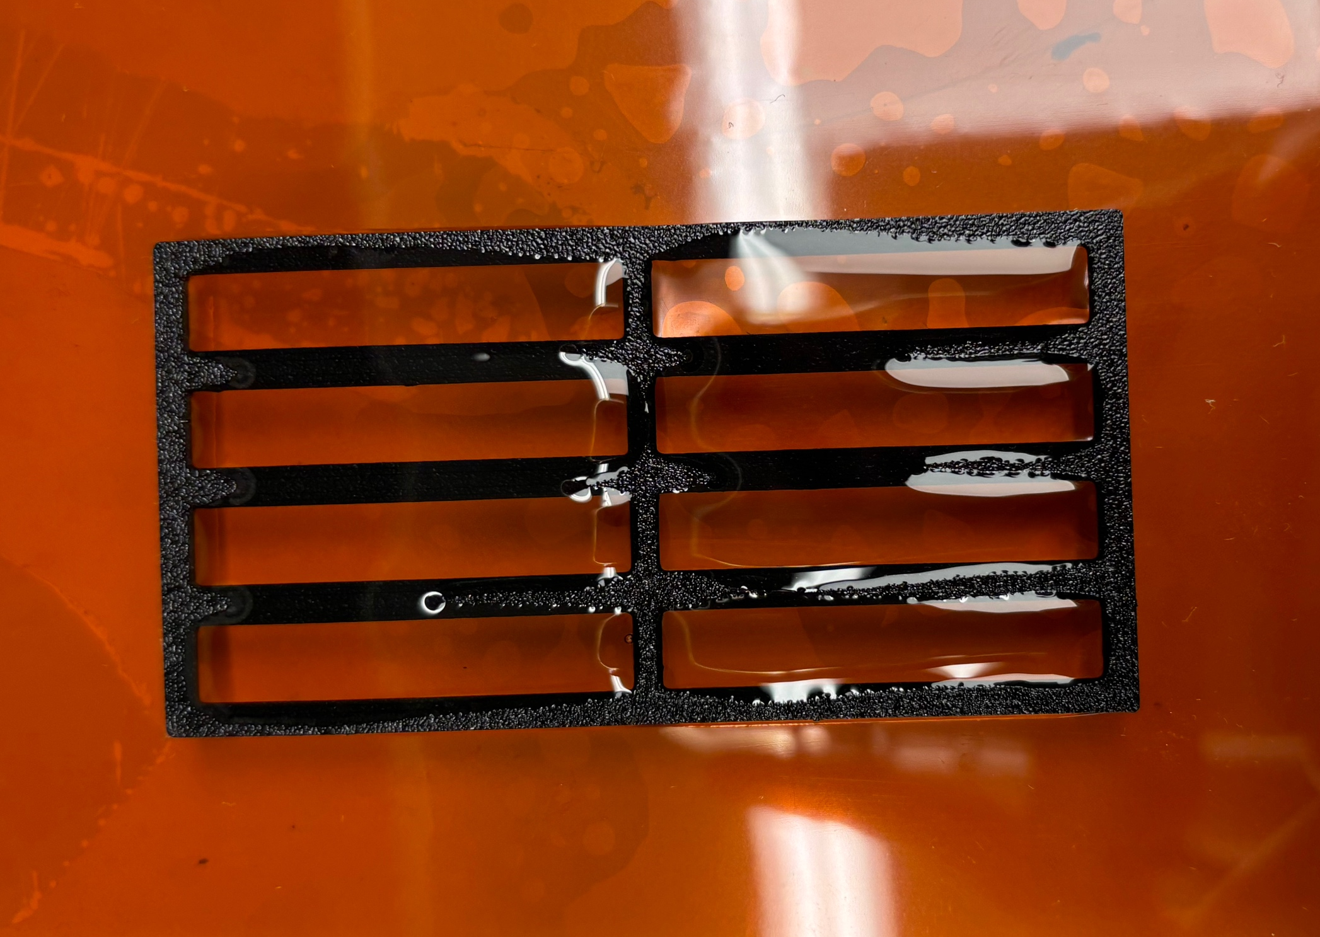
4. Prepare the jig
Cut out and clean off a silicone cookie (assumes you have some prepared already. If not, jump to step 6 then come back once they are cured).
If you need to make more cookies, use the leftover silicone from step 6 (or its own batch of silicone if you have zero cookies available) and fill the mold on top of a piece of Kapton so you have a nice meniscus then roll another clean piece of Kapton on top like you’re putting on a screen protector so you don’t get bubbles. Put a weight on top and leave it for 8 hours.
To clean the cookie, gently run it under slowly flowing water with a tiny bit of soap to get off the little balls of silicone. Pat dry and clean with isopropyl alcohol. Wear gloves if you are touching them with your fingers once they have been cleaned with alcohol.
An array of eight silicone cookies that need to be cut out

Slide 11
4. Prepare the jig
Put the silicone cookie on top of the Kapton pieces you have on the jig. They may need to be trimmed with a razor blade.
Cover the whole jig face with a clean piece of Kapton and put a small weight on top (tweezers will do). This is to keep the set up clean while you do the next step
Foam
Silicone cookie
Copper plate
Kapton
Jig

Slide 12
5. Make silicone. In scintillator shop
Follow the directions in the manual about how to make silicone and make a minimum of 10 g of silicone
Get the syringe and needle and bring the wet silicone, syringe, and needle back to the room above detector facility
In an emergency where you need to fix the triggers ASAP, you can skip steps 5 and 6 and just put a layer of Dow Corning Q2-3067 optical couplant on top of the silicone cookie instead

Slide 13
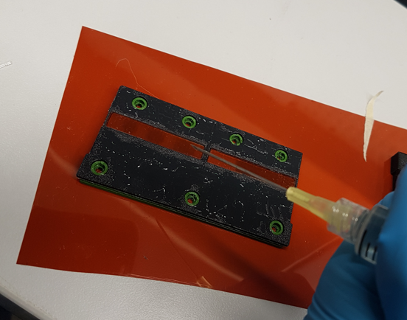
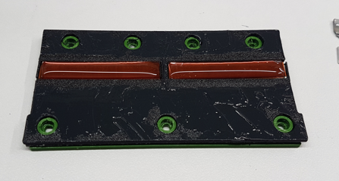
6. Apply silicone. Above detector facility
Attach the needle to the syringe but leave it capped.
Slowly pour silicone down the inner side of the syringe to fill it so you don’t introduce air bubbles.
Insert the plunger, remove the cap and turn the syringe needle-end up. Push air bubbles out
Add a line of silicone on top of each silicone cookie. Start small, it will spread. You should have a nice meniscus.

Slide 14
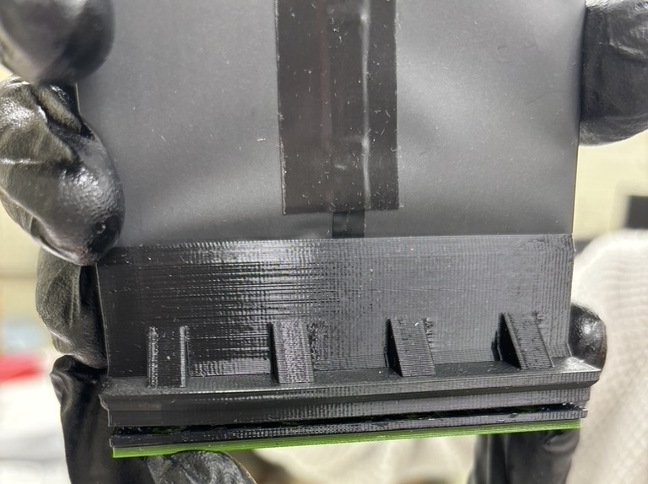
7. Attach scintillators and holder
Do this next step very carefully, if you make a mistake you need to clean everything and restart from the beginning of step 6
Clean the exposed end of the light guides
Carefully place the holder on top of the jig. This must be done in a straight down motion, not by putting it down on one end of the jig first and rolling the other side down.
Make sure you have the holes on the jig and the holder correctly matched
You have one try. If you make a mistake (backwards, crooked, etc) you need to take it apart, clean everything and restart from the beginning of step 6
From this step onwards, the paddle must remain vertical for the next 8 hours, minimum
Must stay like this but on the table

Slide 15
8. Screw jig and holder together
Slide the jig/scintillators/holder combo to the edge of the table, keeping it vertical, so that one of the holes overhangs off the edge
From below, screw the holder to the paddle using M2x6mm screws
Readjust so that a screw hole on the opposite end is visible and repeat until all holes are filled
Tighten the screws just enough to have some compression. Don’t crank them
Slide the paddle to the back of the table and put up a sign telling people not to touch it. Cover the light guides that stick up with a drape of tedlar. Let it sit like this for a minimum of 8 hours

Slide 16
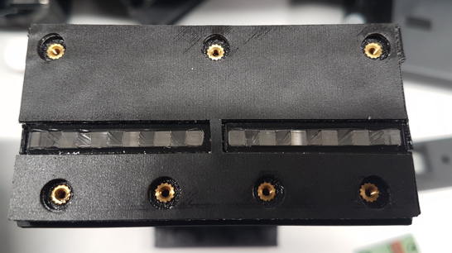
9. Inspect
Remove the jig and check for bubbles
Ideally, the silicone cookie should be moderately firmly attached to the light guides and look solid
If you see bubbles between the light guides, it’s not ideal but we can work with it
If you see bubbles on the light guides, remove the silicone and restart from step 4
You can use a clean Allen key to put down on (not between) the light guides and check for a good connection
Good one (yours will have the copper plate)

Slide 17
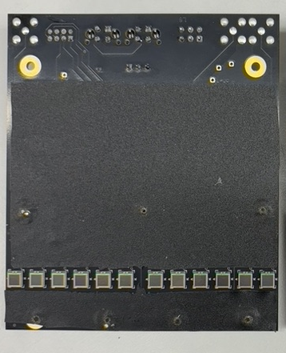
10. Attach PCB
Skin
Clean the SiPMs of a pre-amplifier board with a tiny bit of alcohol
Cover the PCB (side with the SiPMs) with a piece of the skin (remove the part that would cover the SiPMs)
There is a protective cover on both sides of the skin that must be removed
Place the board on the holder in place of the jig and use the M2x6mm screws to screw it on. Only put the screws in the holes marked on the picture

Slide 18
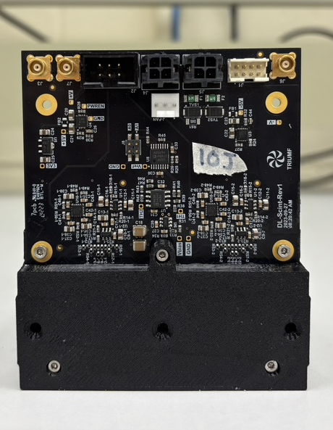
11. Attach back cover
Click the back cover on the back of the paddle and screw it in using three M2x10mm screws

Slide 19
12. Repeat
Repeat steps 1-10 for the other side of the paddle
If this is for the test set up, then after doing the other side all you need to do is wrap it in tedlar and use black tape to seal all seams of the paddle around the holder and the edges of the tedlar to prevent light leaks
If this is for the experiment, proceed to step 13 after finishing the other side.

Slide 20
13. Assemble frame
Once four paddles are assembled, line them all up and attach them together on each end using the grey metal bar. Screw into the heat inserts that are along the middle of the back cover.
Attach the metal bar to the black t-slot, making sure there is something under the t-slot to support it so you do not put extra stress on the scintillator or the light guide joints
Cut a long piece of tedlar and wrap it around the scintillator. Make a cut at the bend so it’s easier to get a clean wrap.
Seal all seams with black tape.

Slide 21
